Slide 1
Cyber Security @ UWE

Slide 2



Cyber Security at UWE
NCSC Gold Academic Centre of Excellence in Cyber Security Education (ACE-CSE)
NCSC-certified MSc Cyber Security
NCSC-certified Cyber Security Technical Professional (Degree Apprenticeship)
BSc Cyber Security and Digital Forensics
Regional: Outreach / Bootcamps / Workshops
National: CISSEUK, ACE-CSE network
Research: Partnership PhD Scheme
Research: Cyber Security and Cyber Crime Cluster (CSC3)
Research: NCSC / DSTL / EPSRC / industry funding opportunities

Slide 3

Teaching
Laboratory

Slide 4
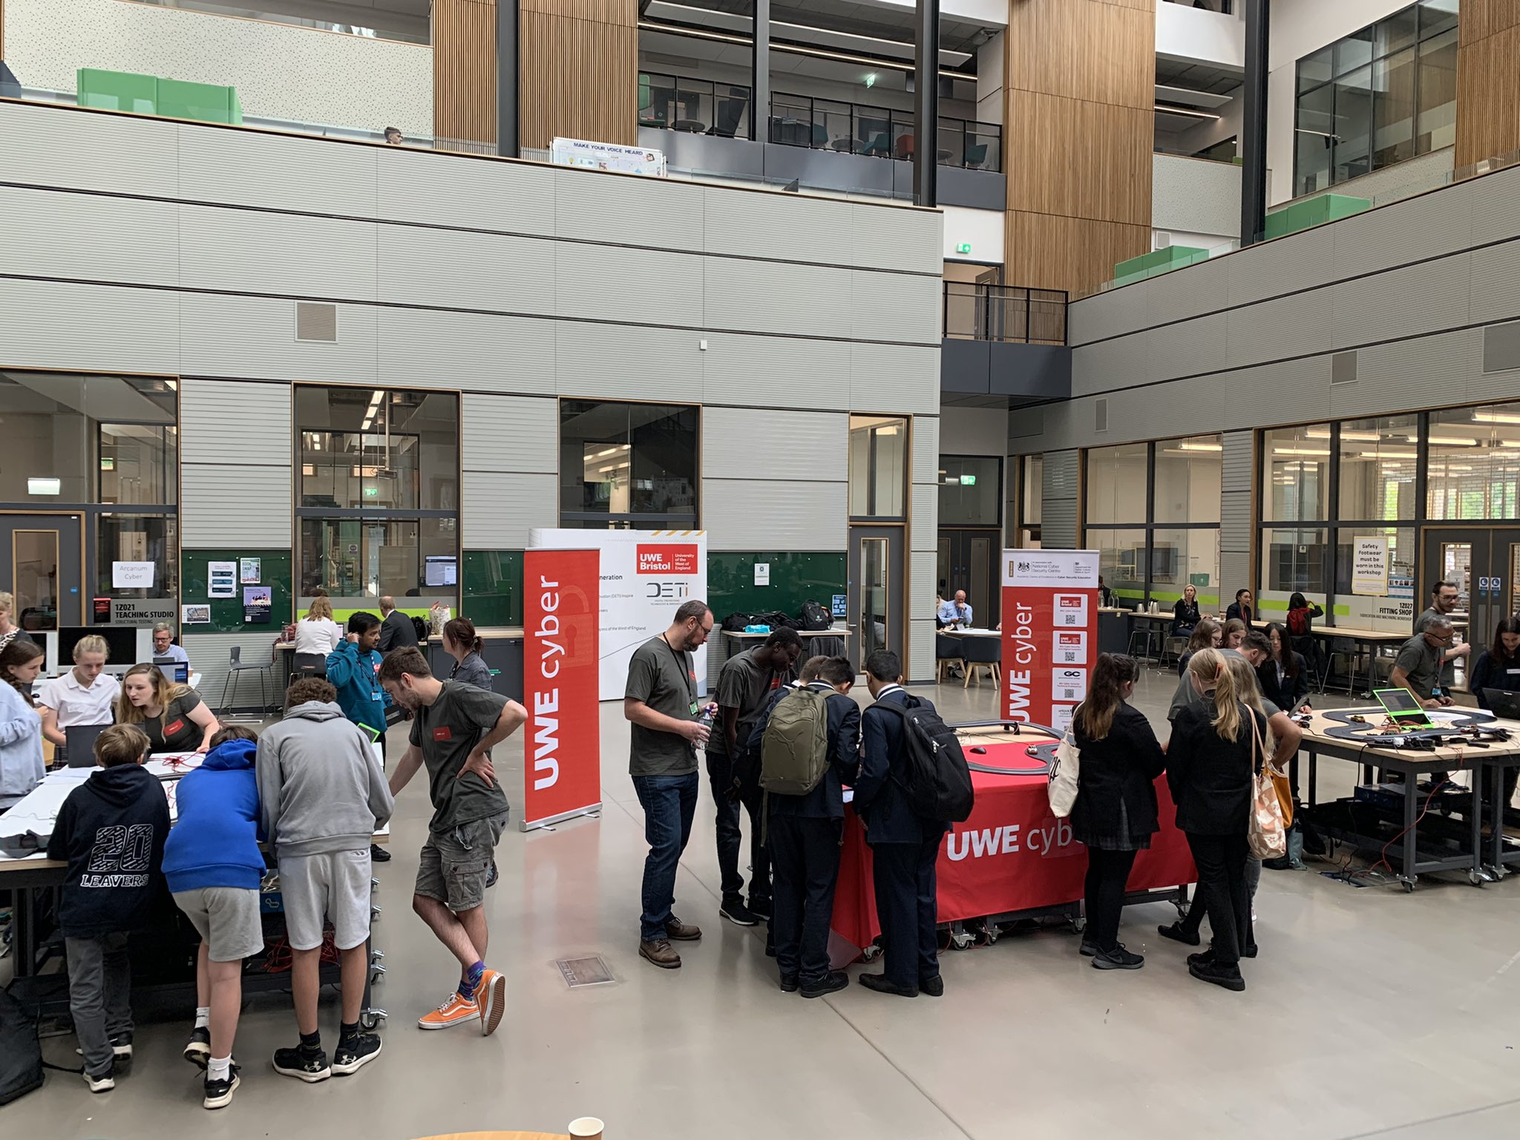
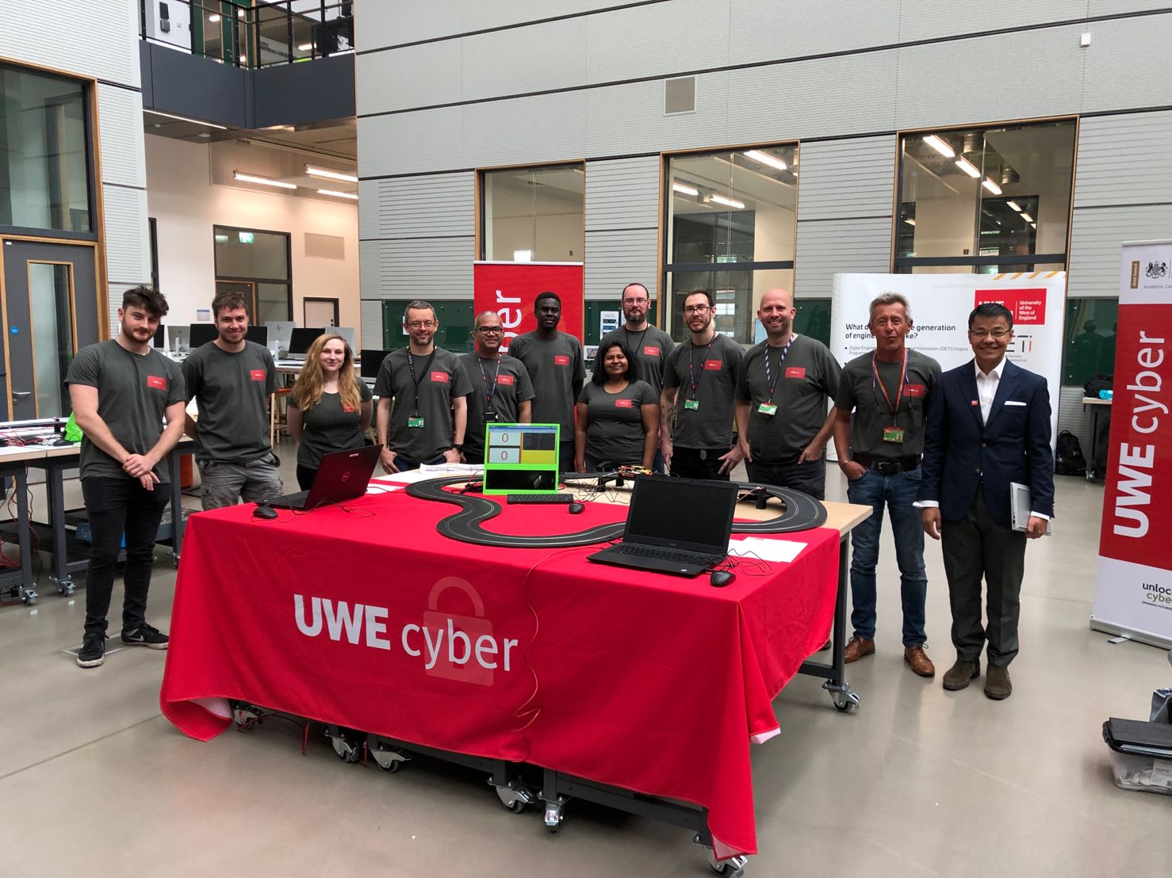












Cyber Security Education Outreach

Slide 5
Research
Laboratory

Slide 6
UWEcyber Research Themes
Software, Cloud and Infrastructure Security
Container-based, Software Security, IoT, CAV, Hardware
Cyber Security Data Analytics
ML for Security, Security of ML, Explainable AI, Privacy, Transparency and Trust
Cyber Crime and Domestic Cyber Security
Online Harms, Forensic Analysis, Dark Web, Financial Crime
Pedagogical Research for Cyber Security
Effective interactive methods for teaching and learning

Slide 7
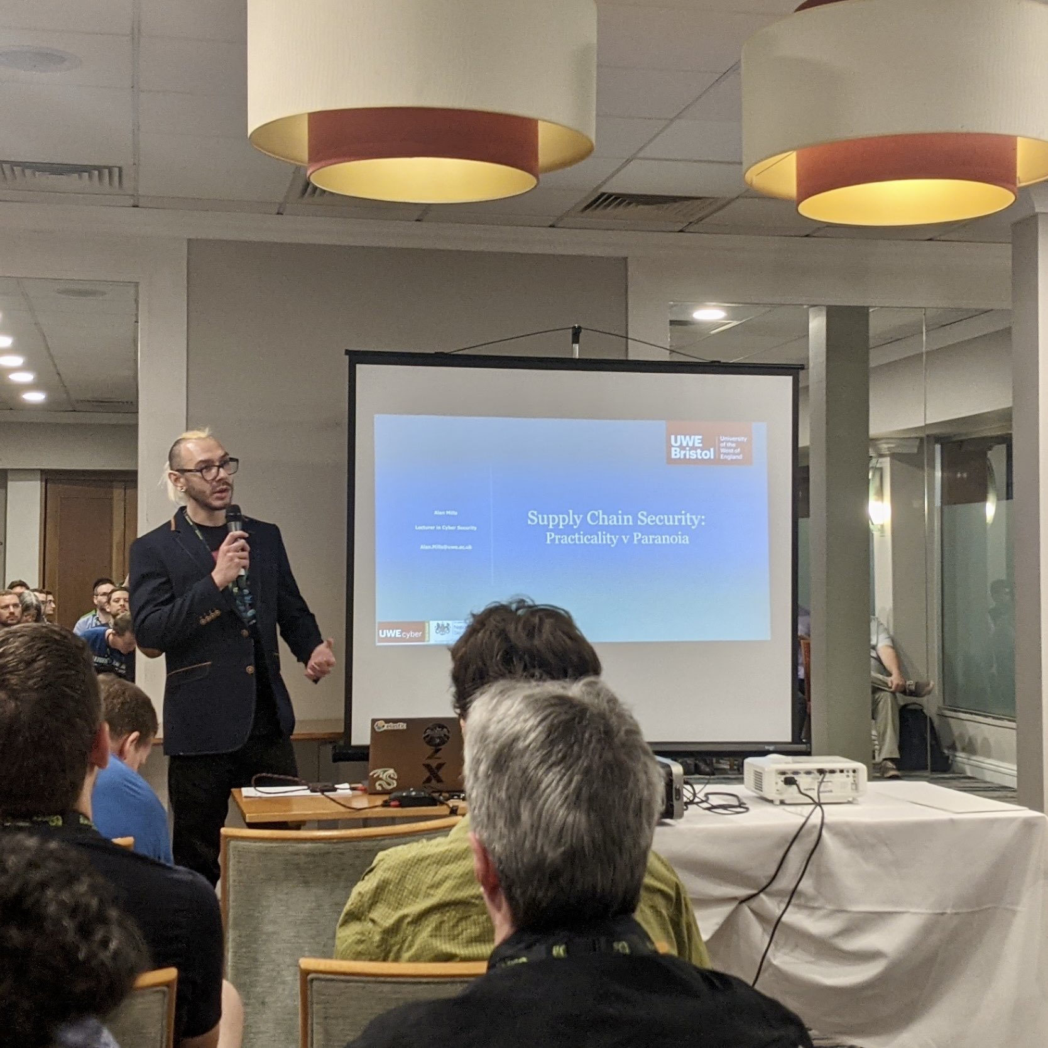
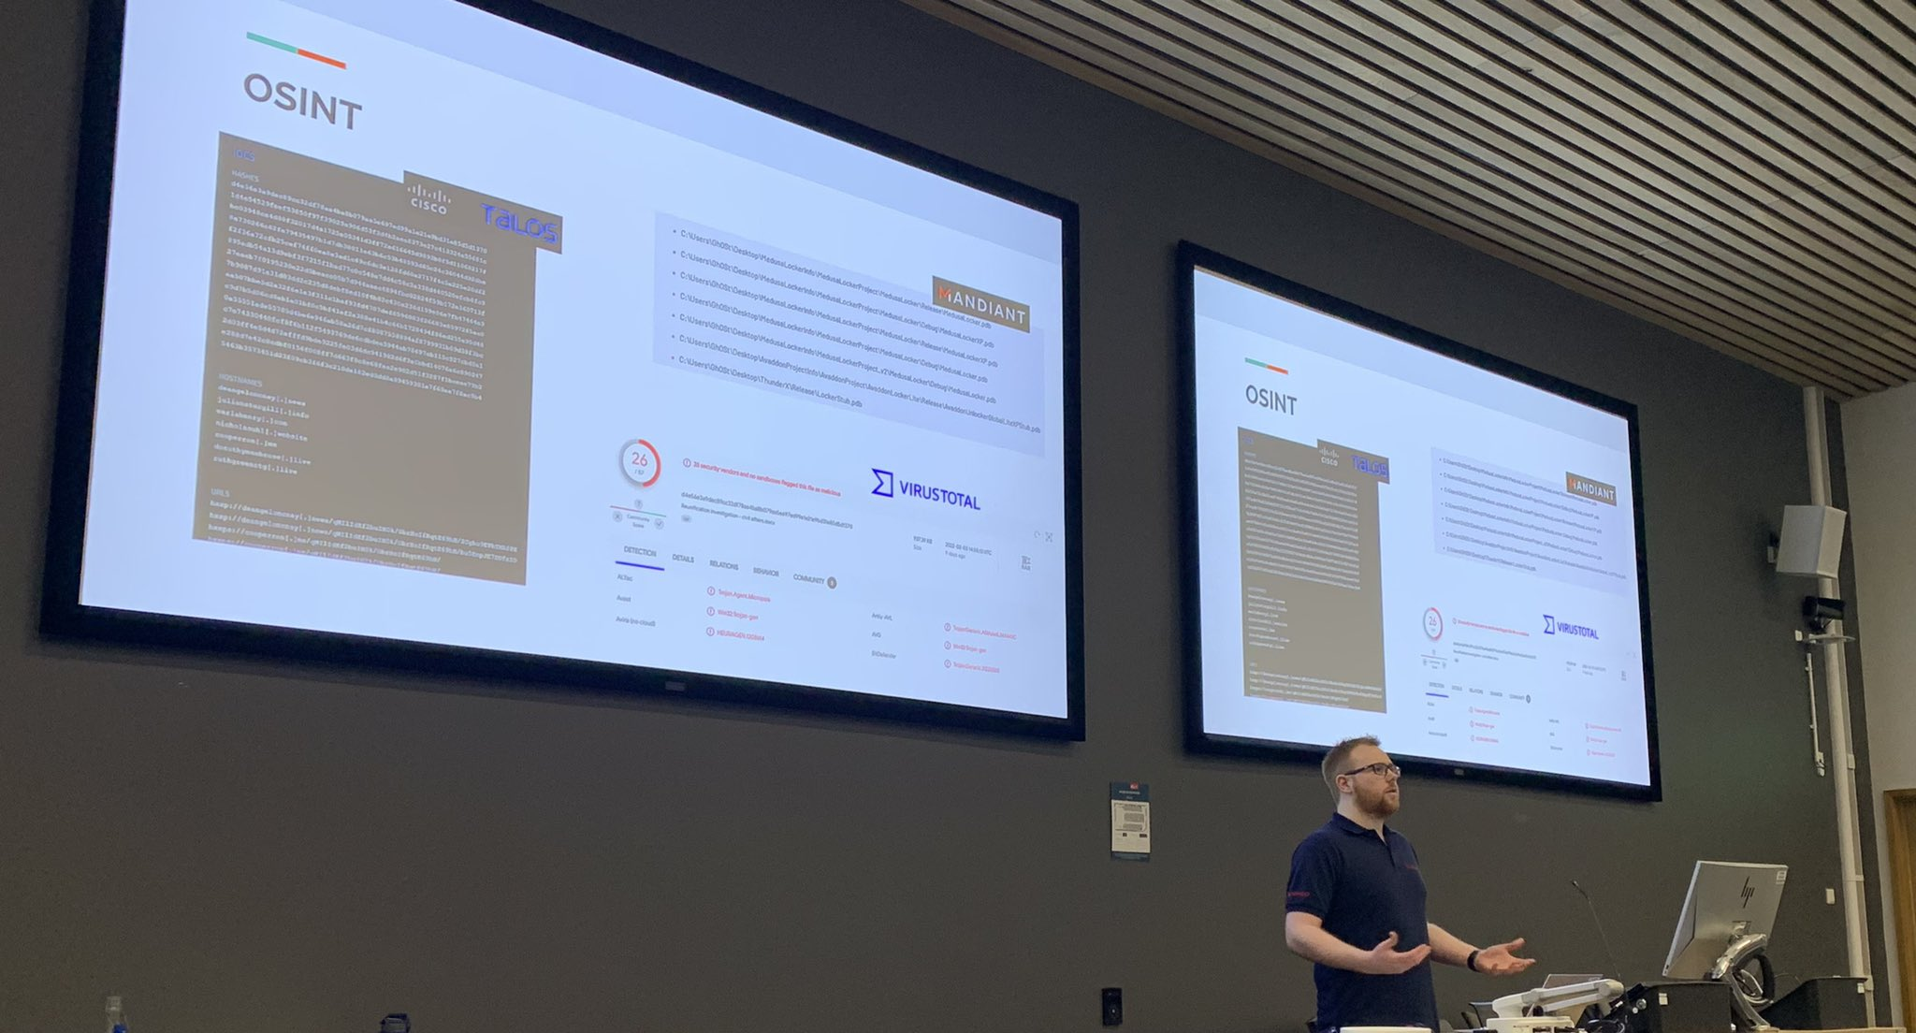
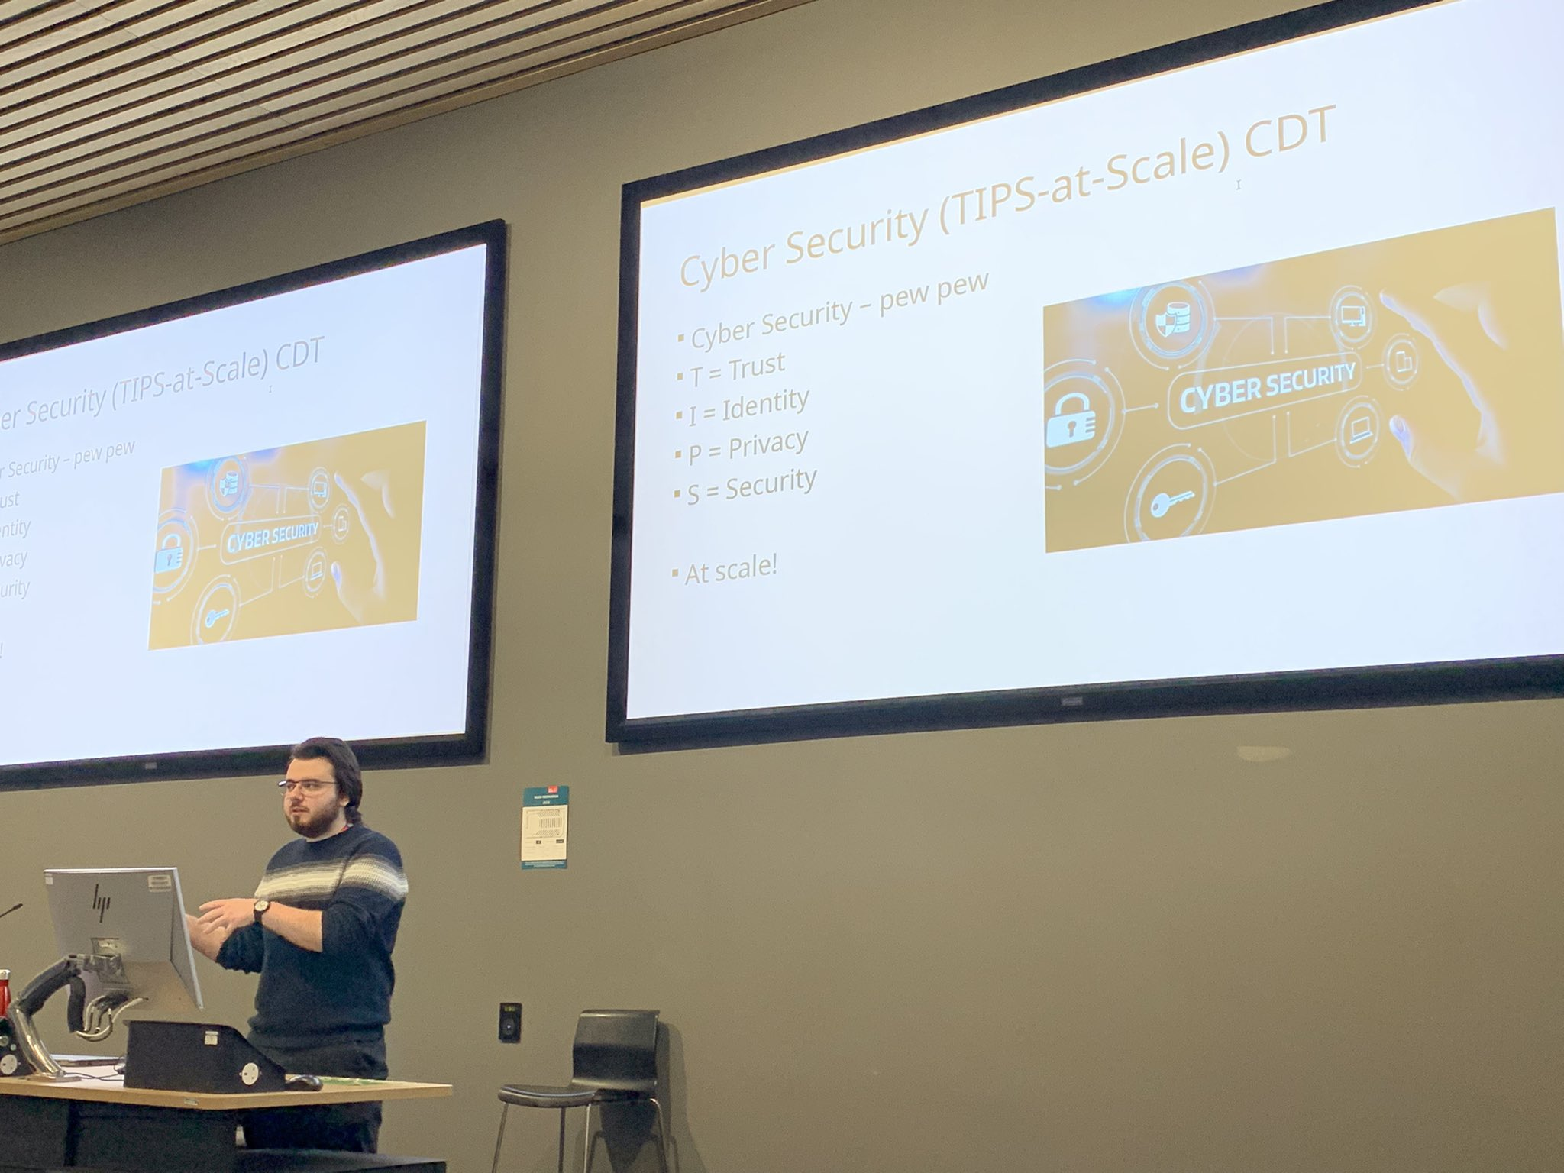
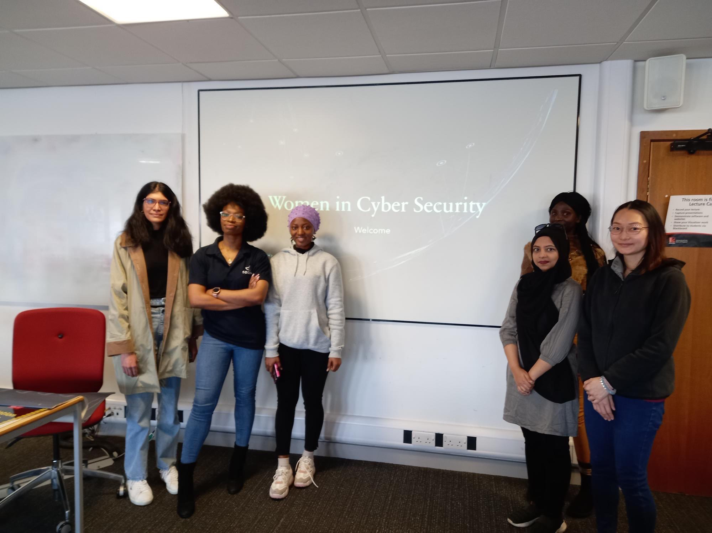
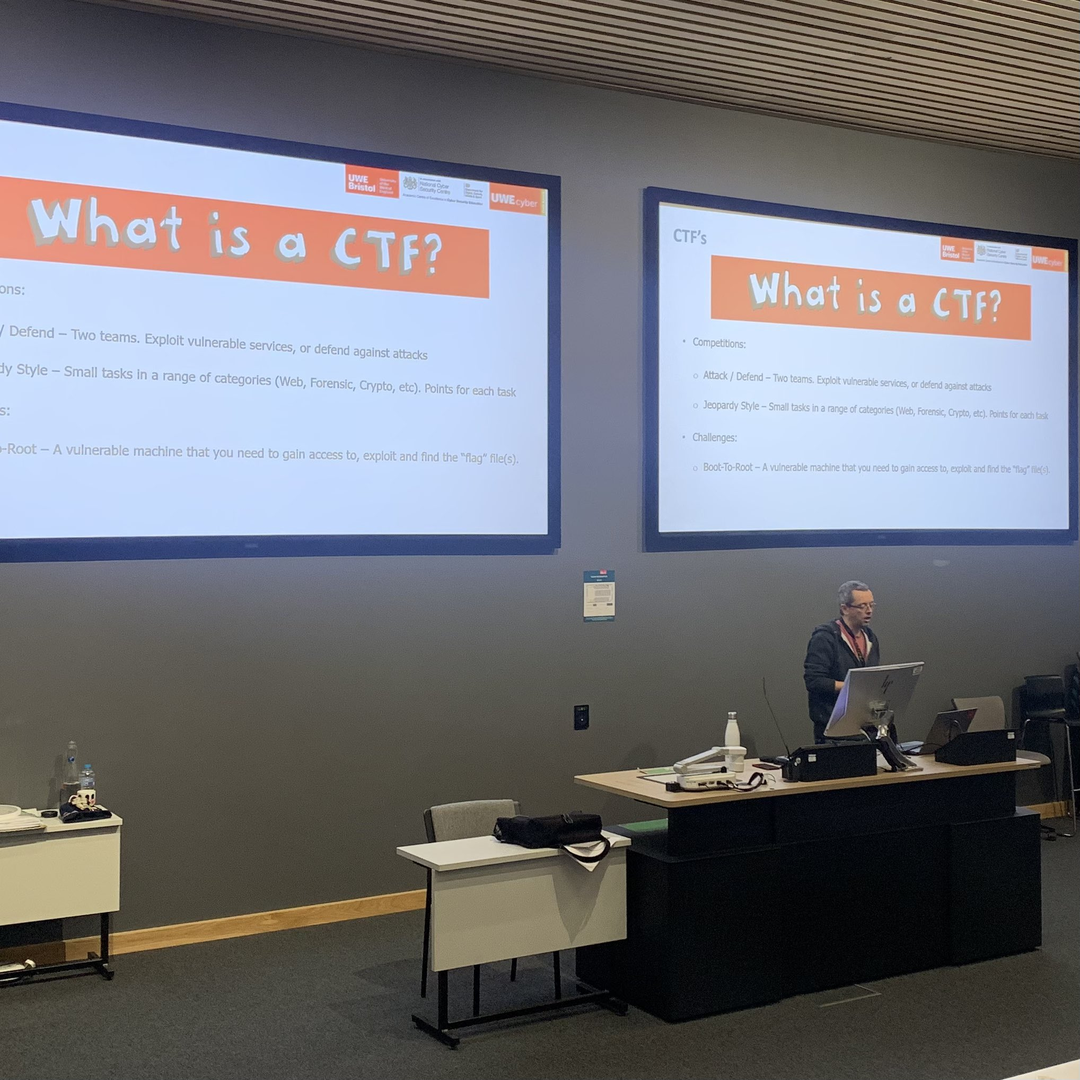

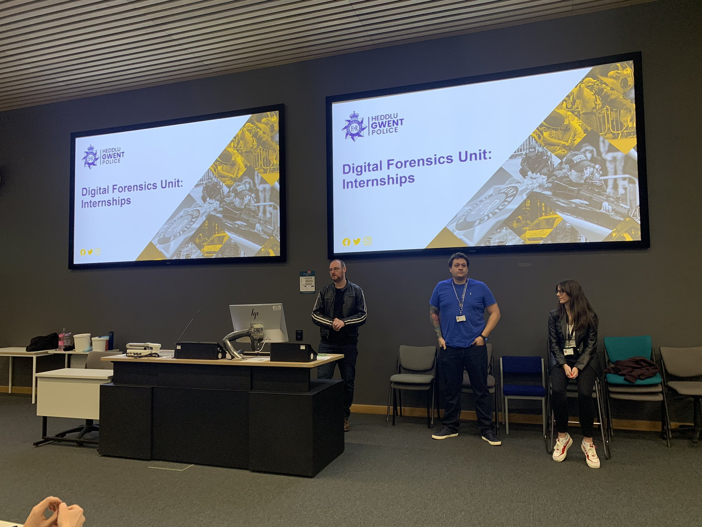
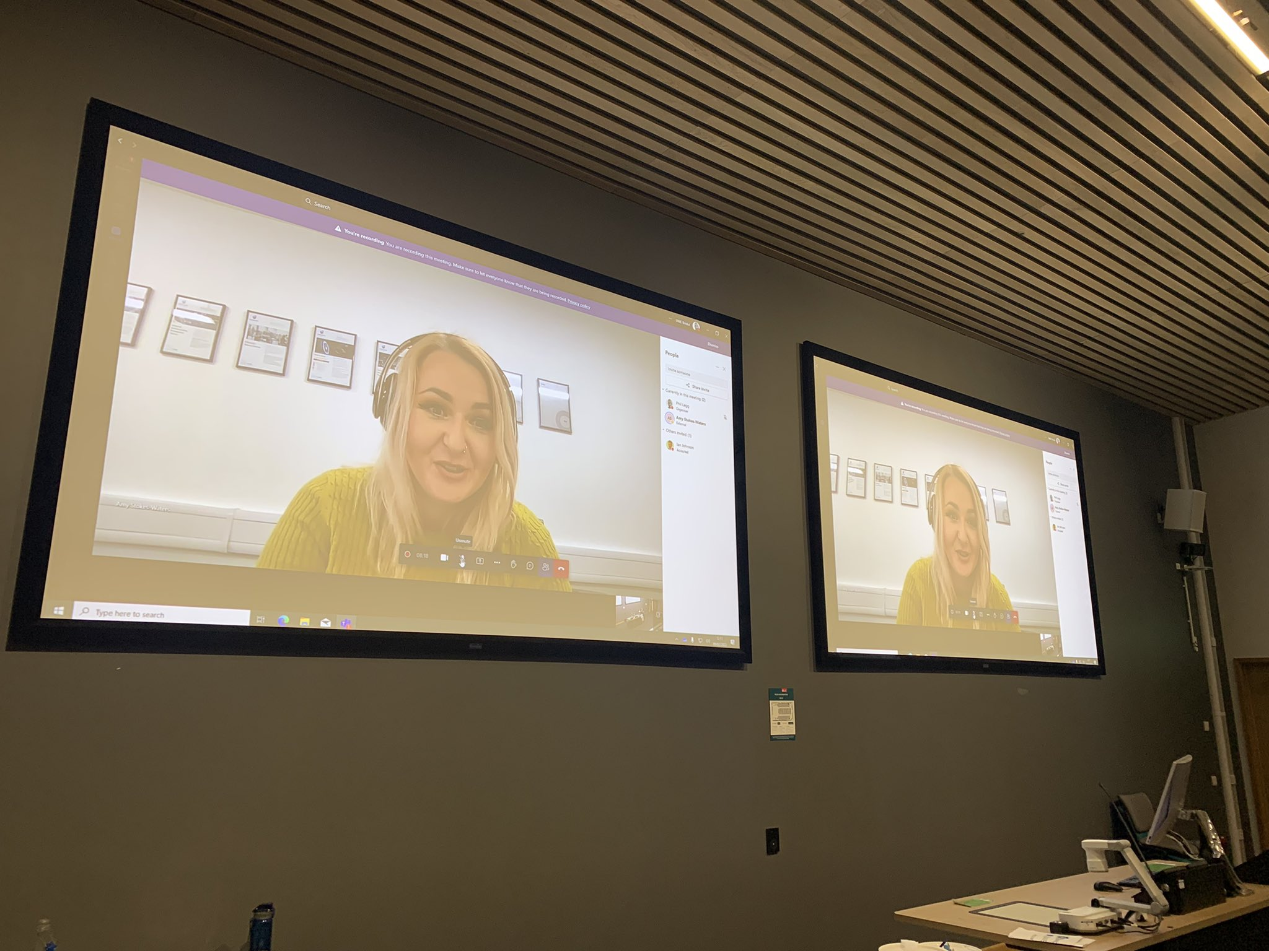
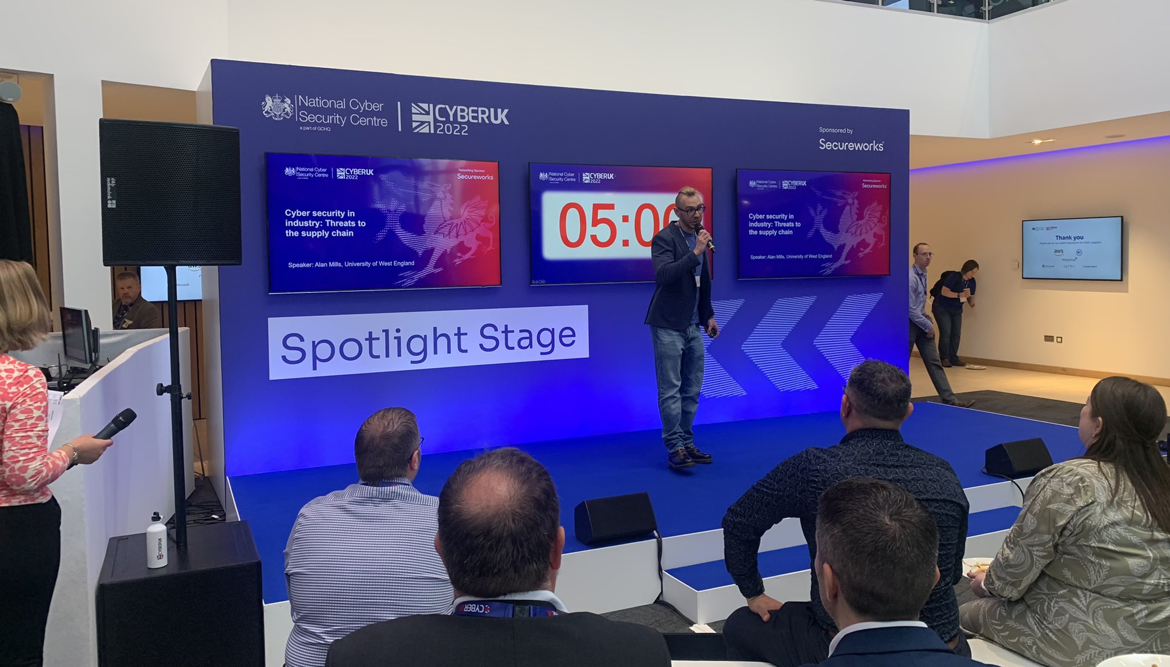
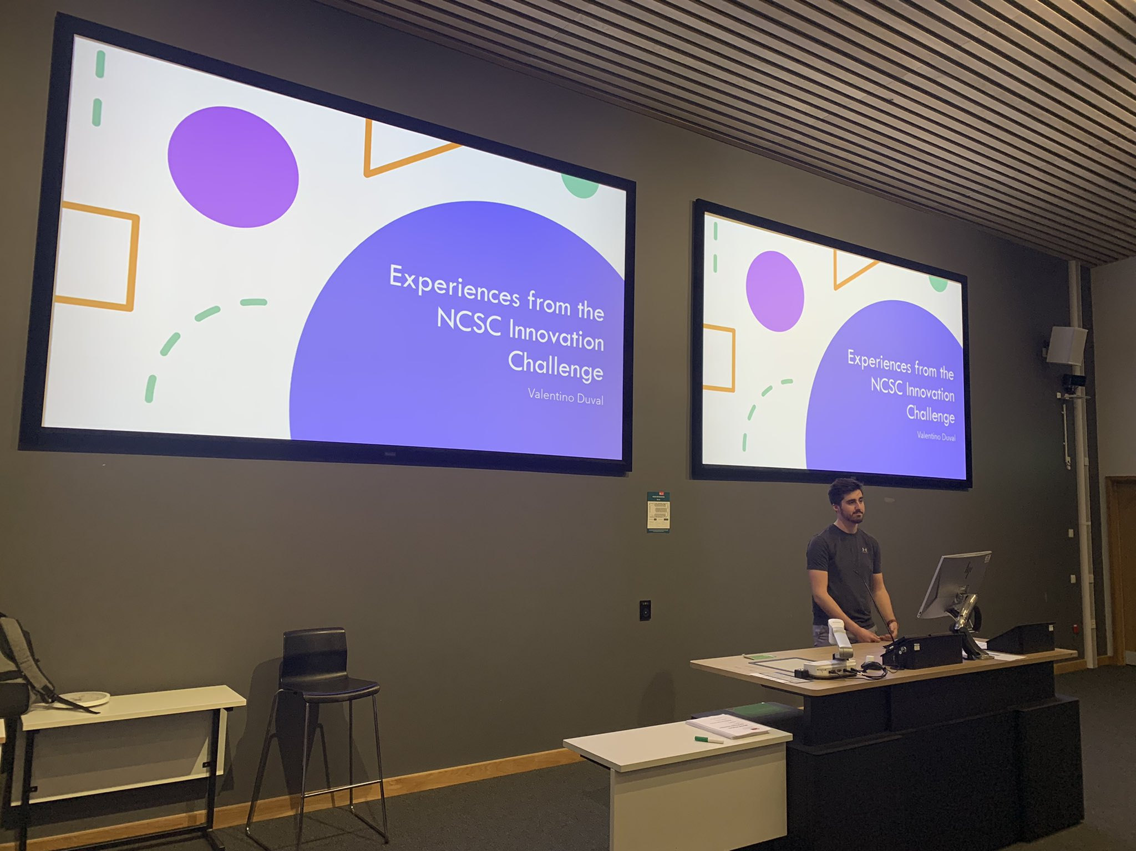
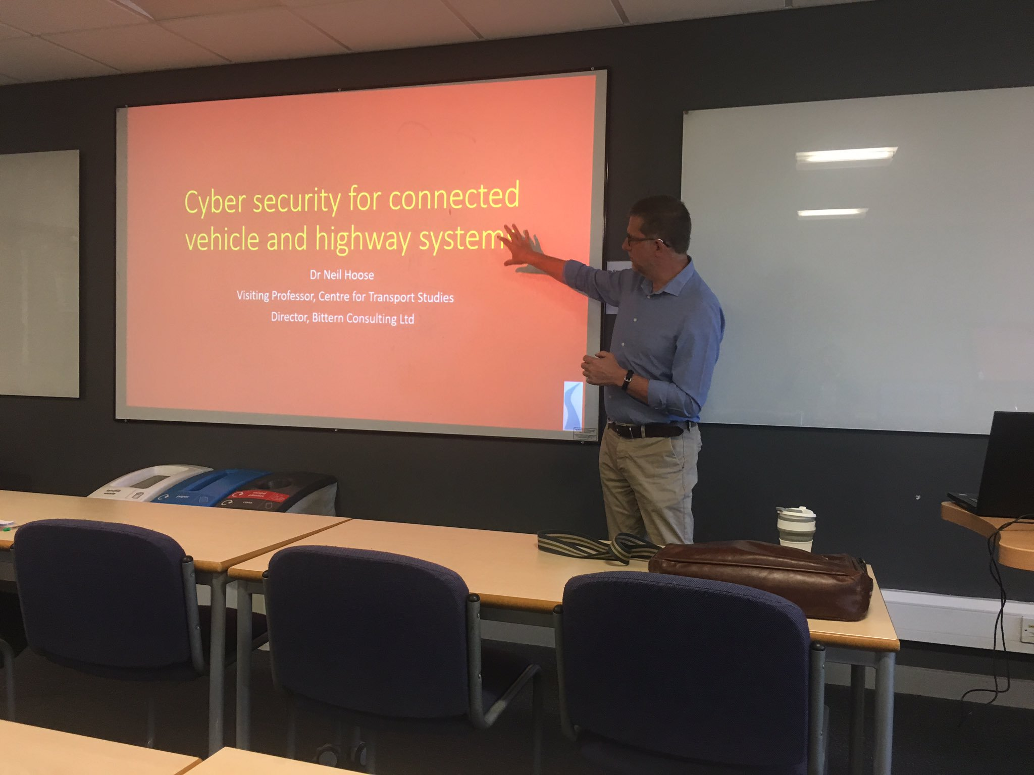
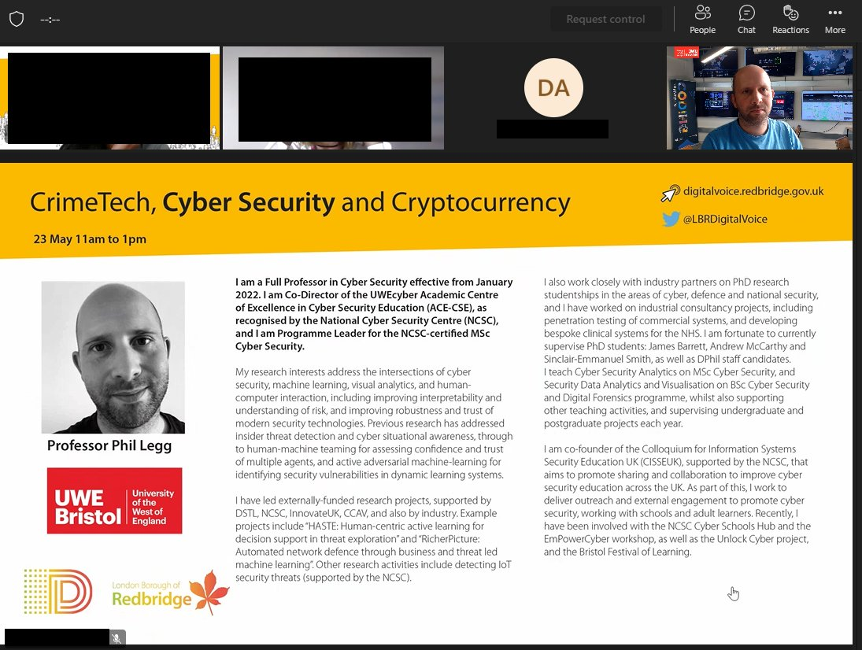


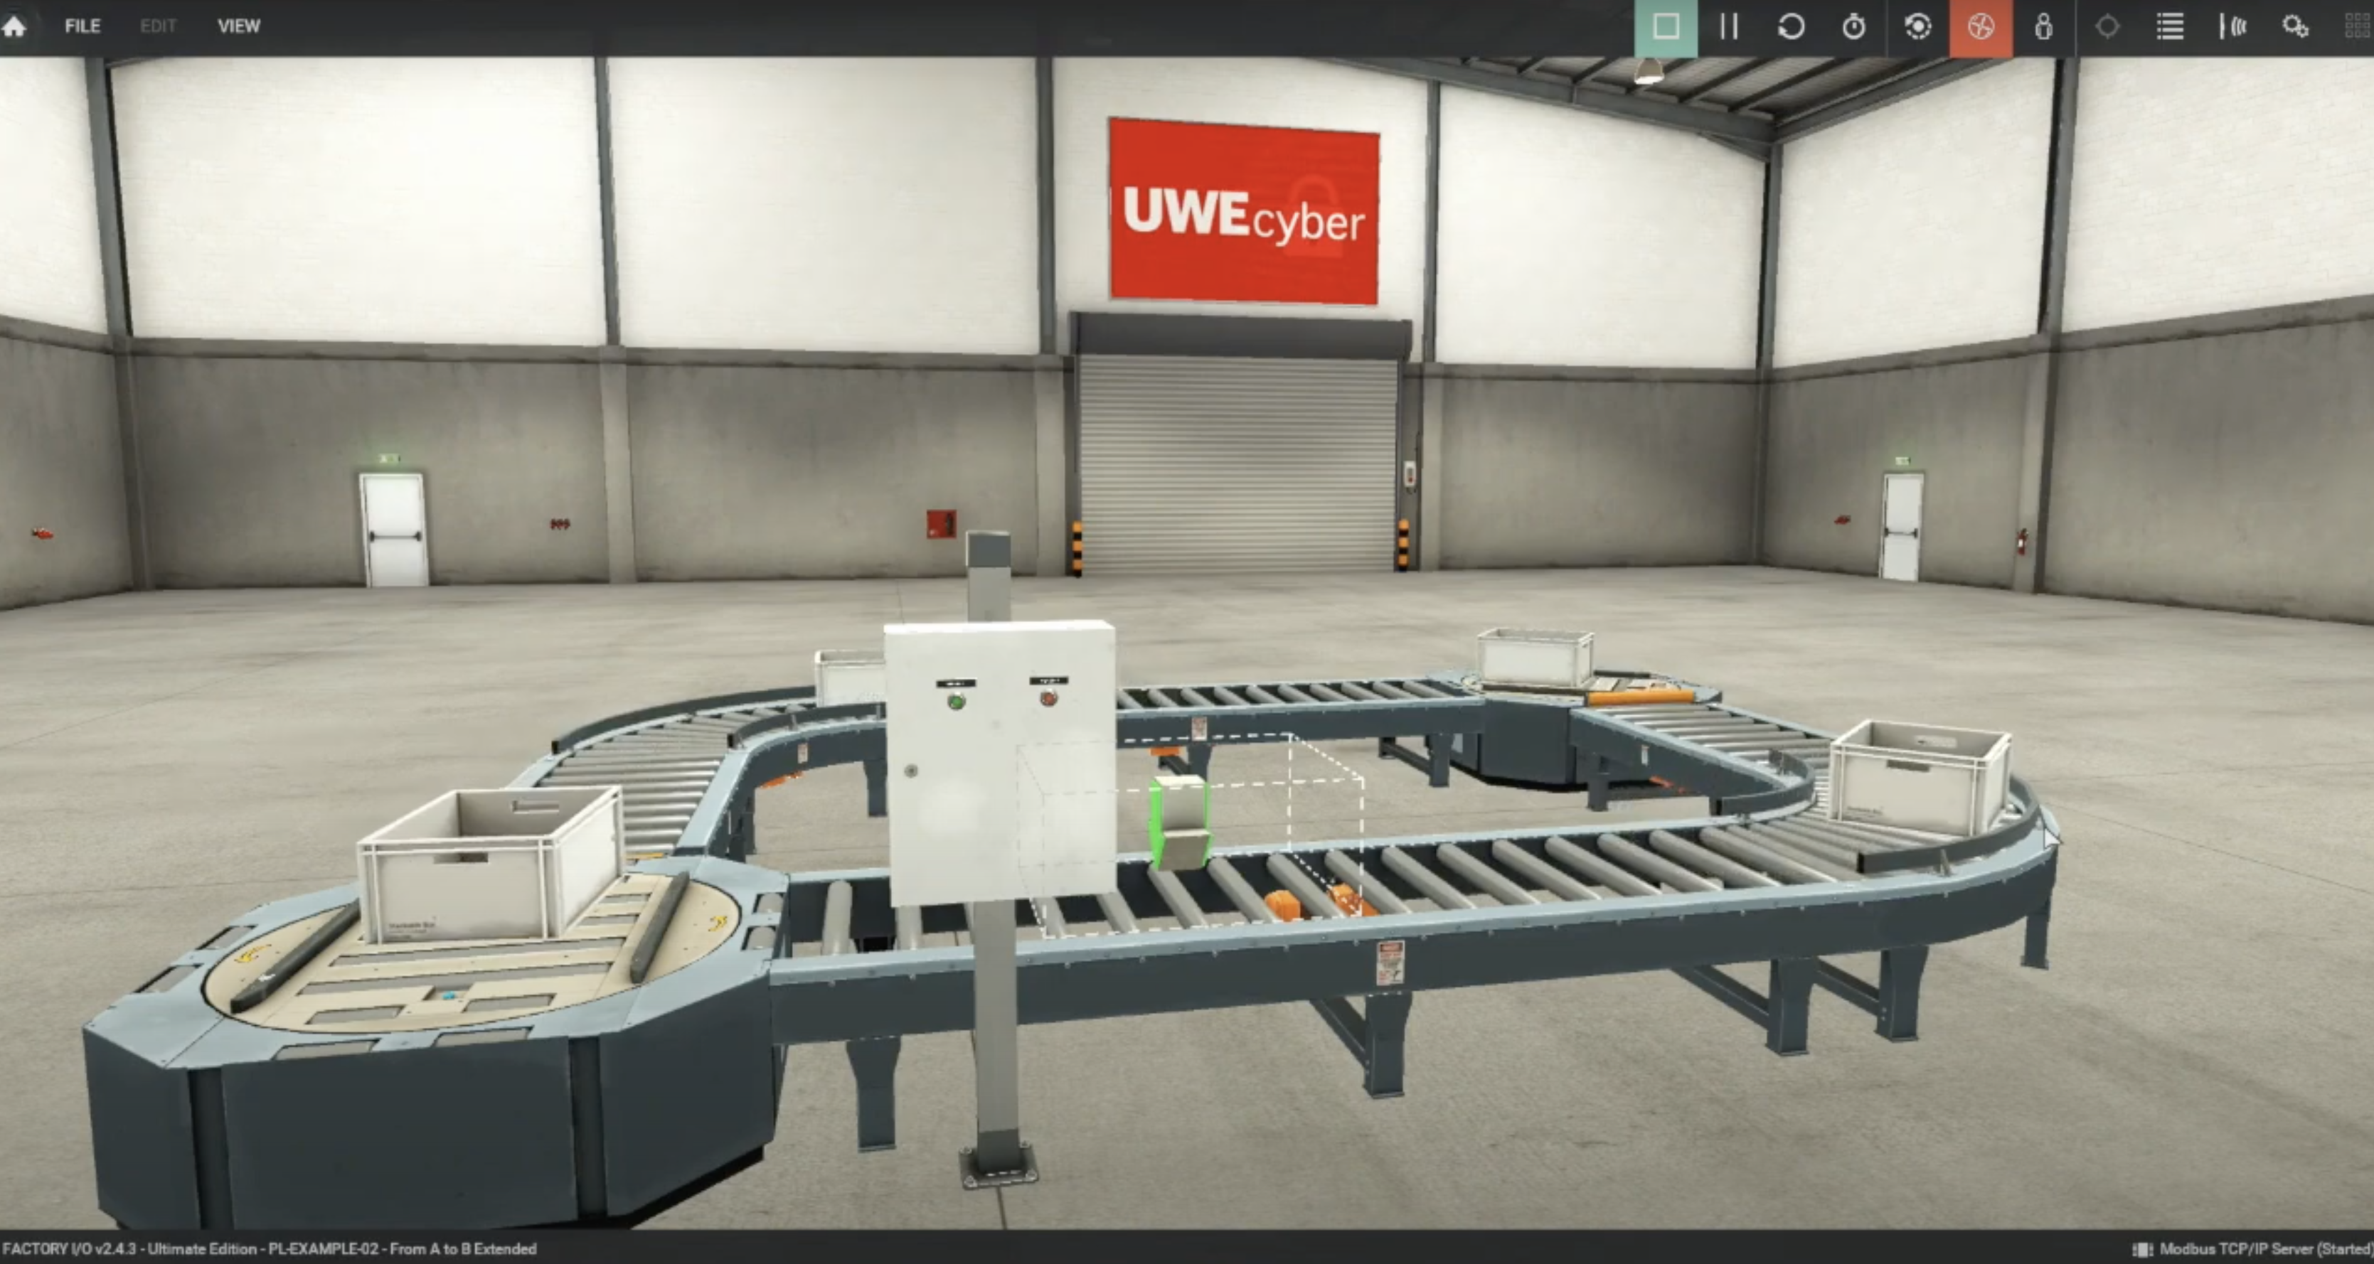
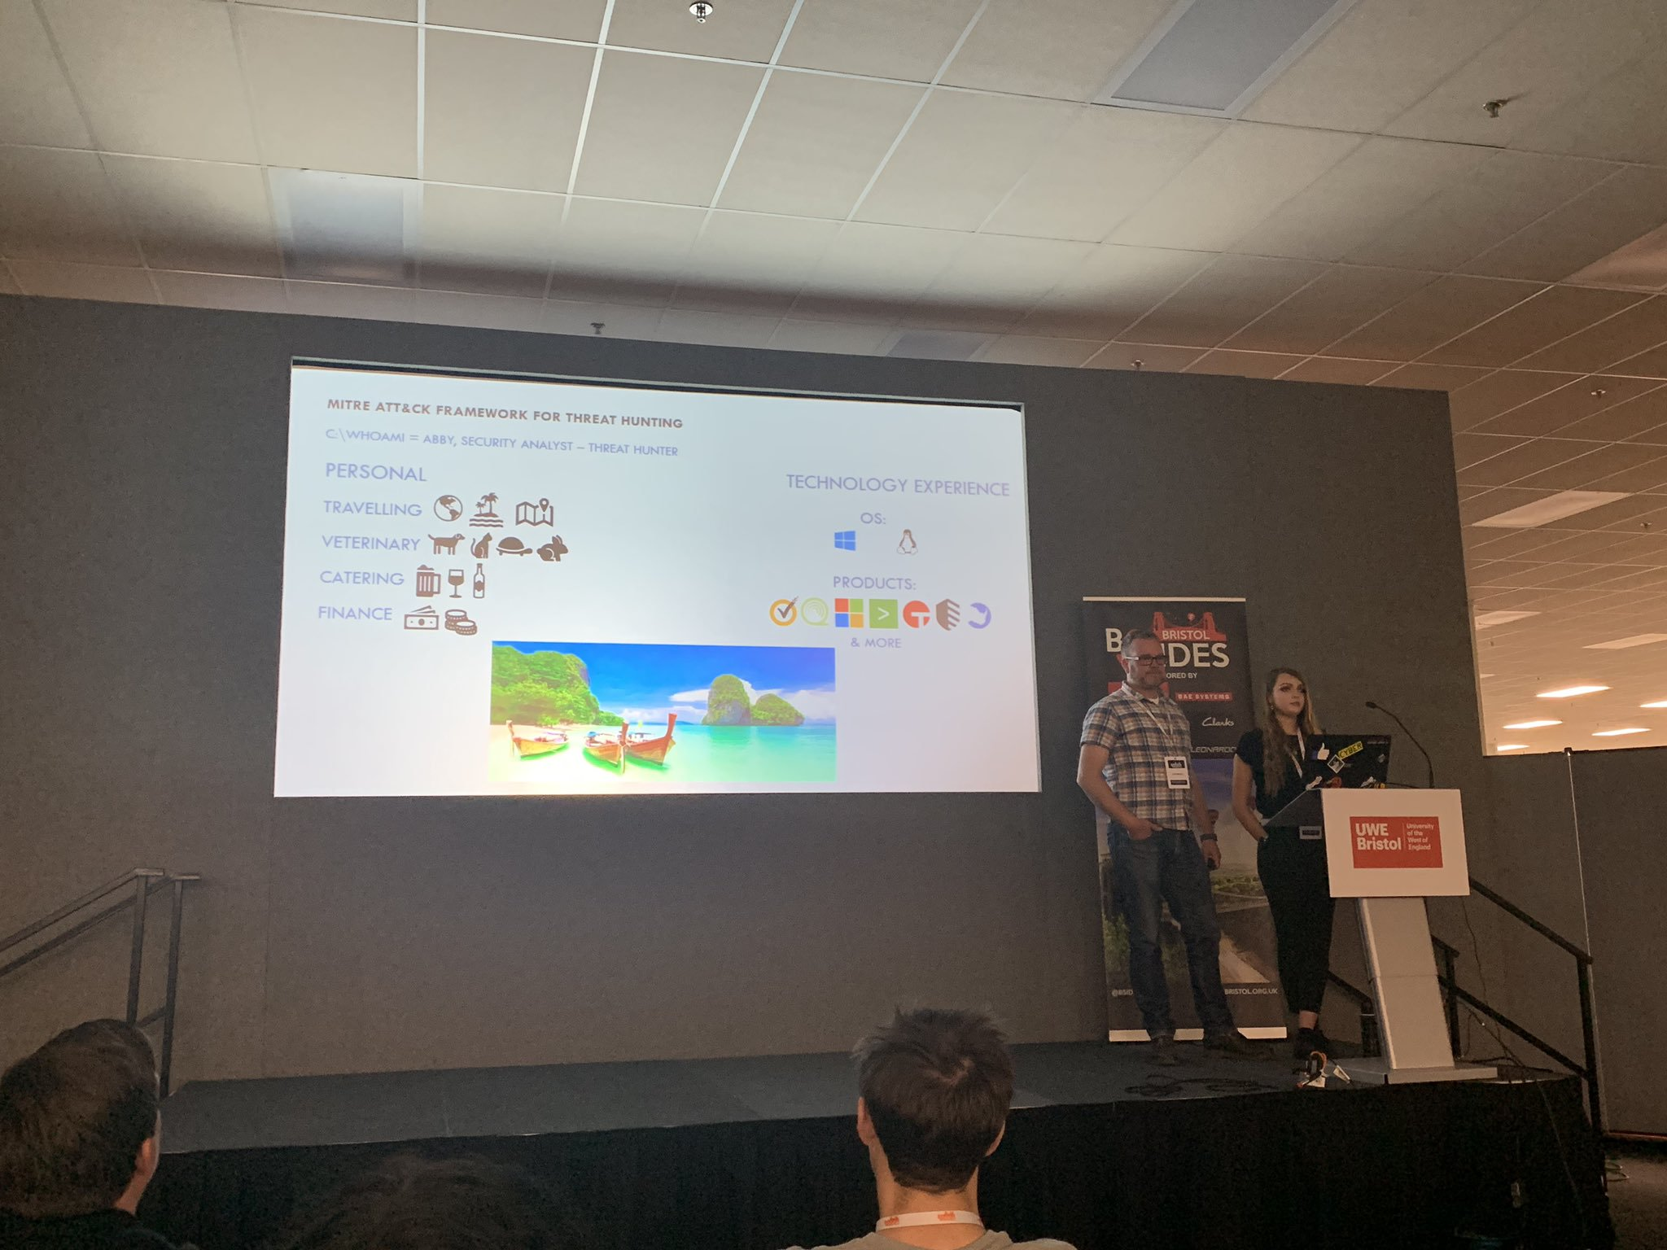

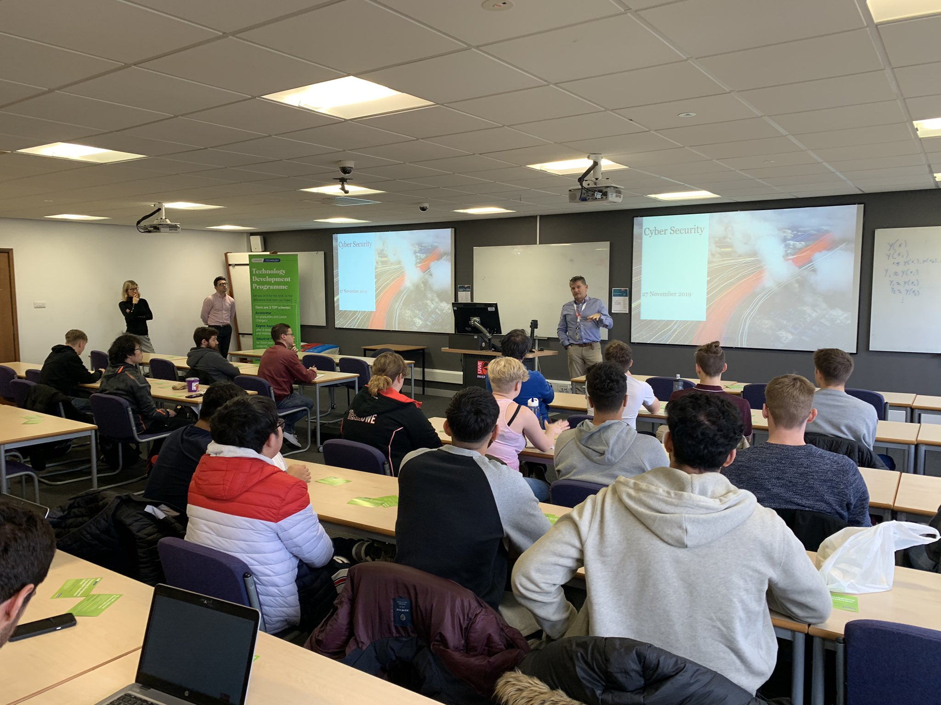
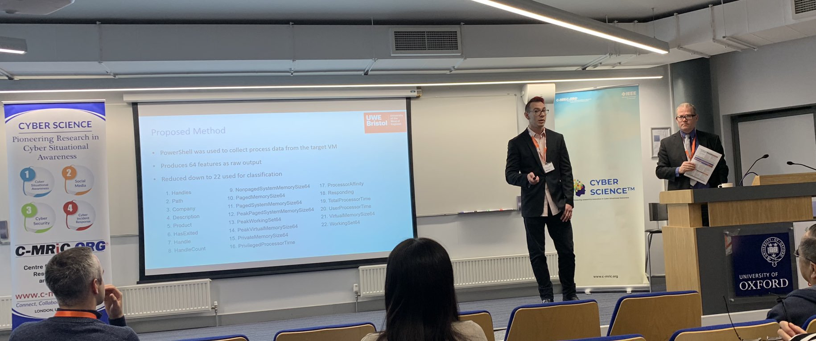


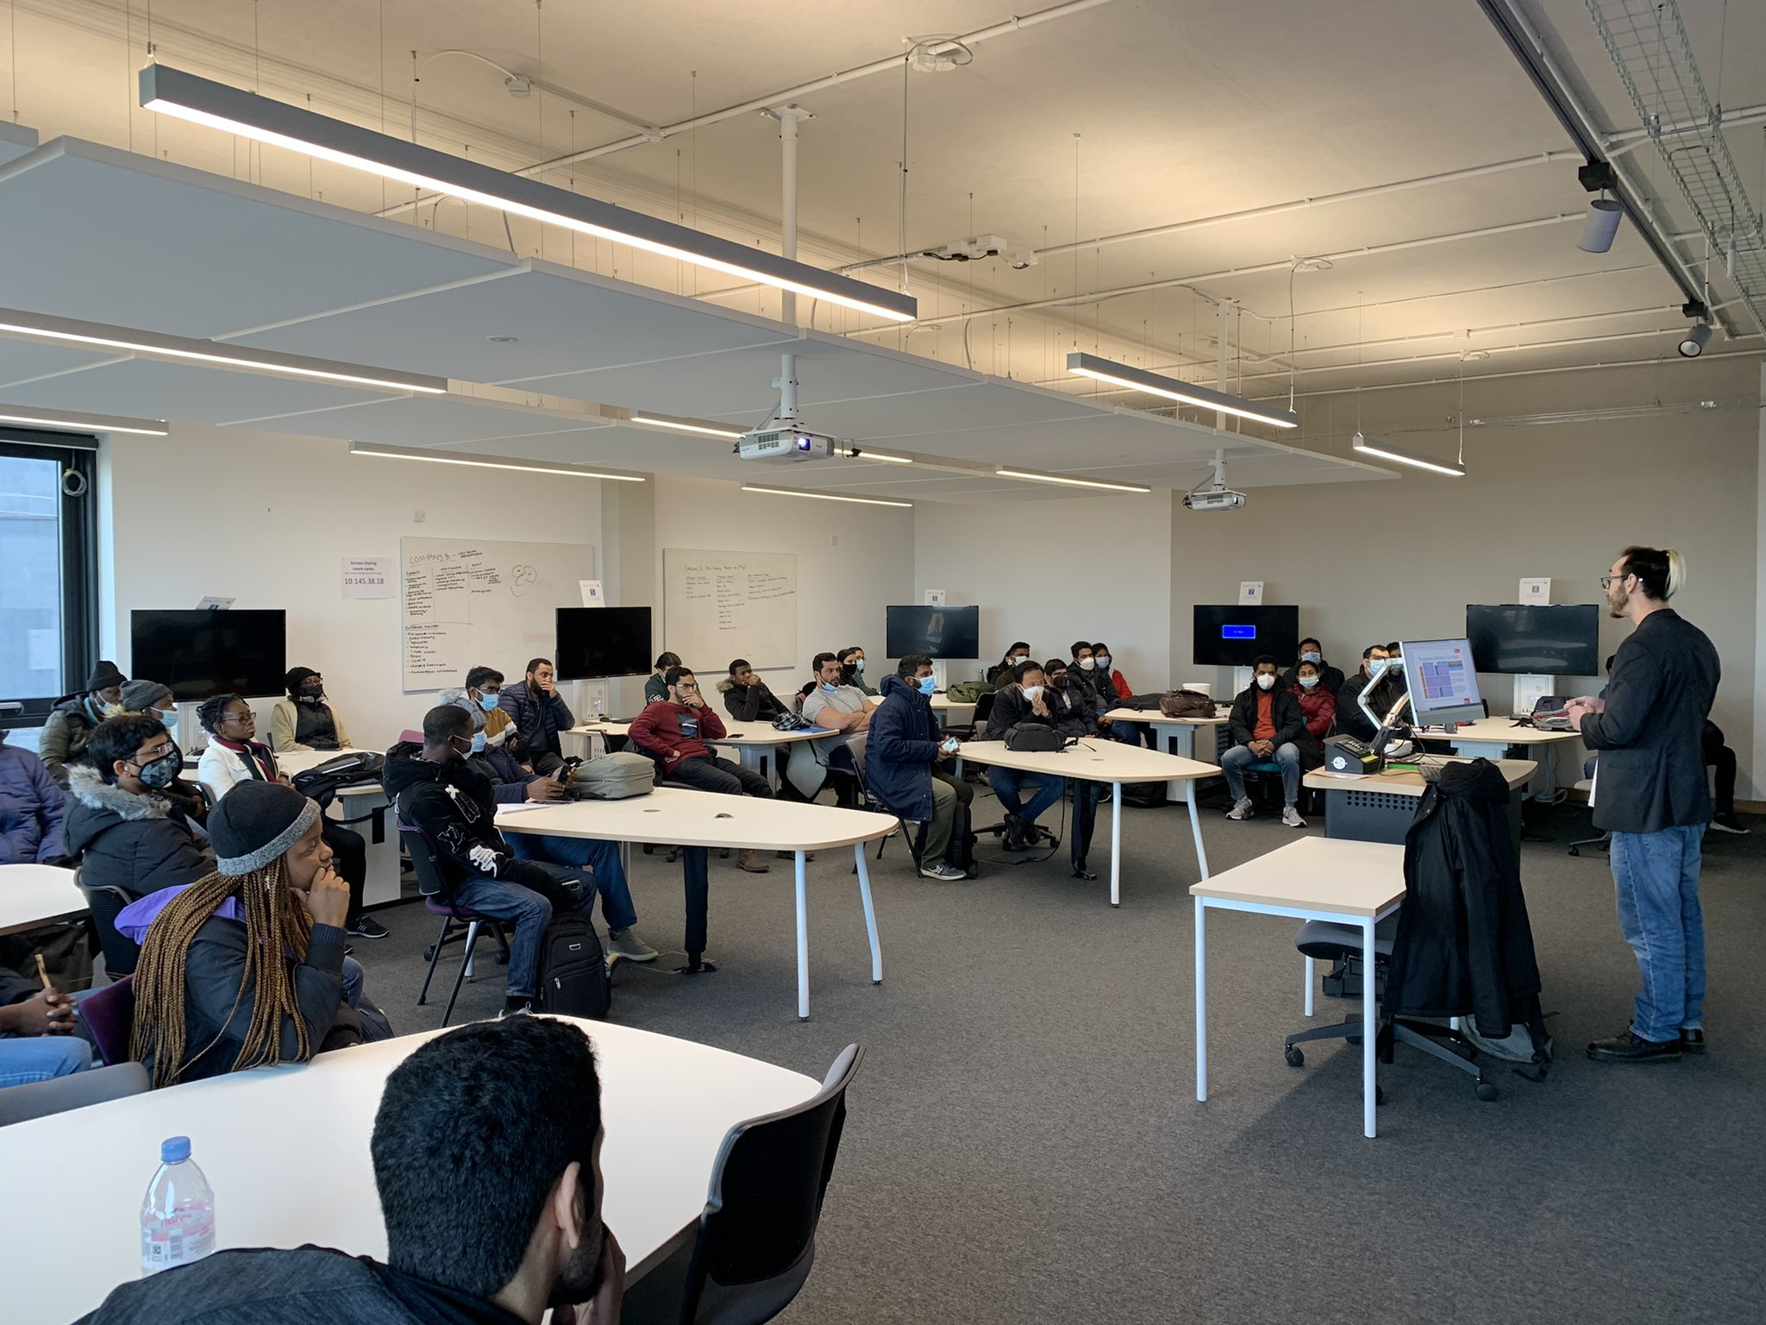
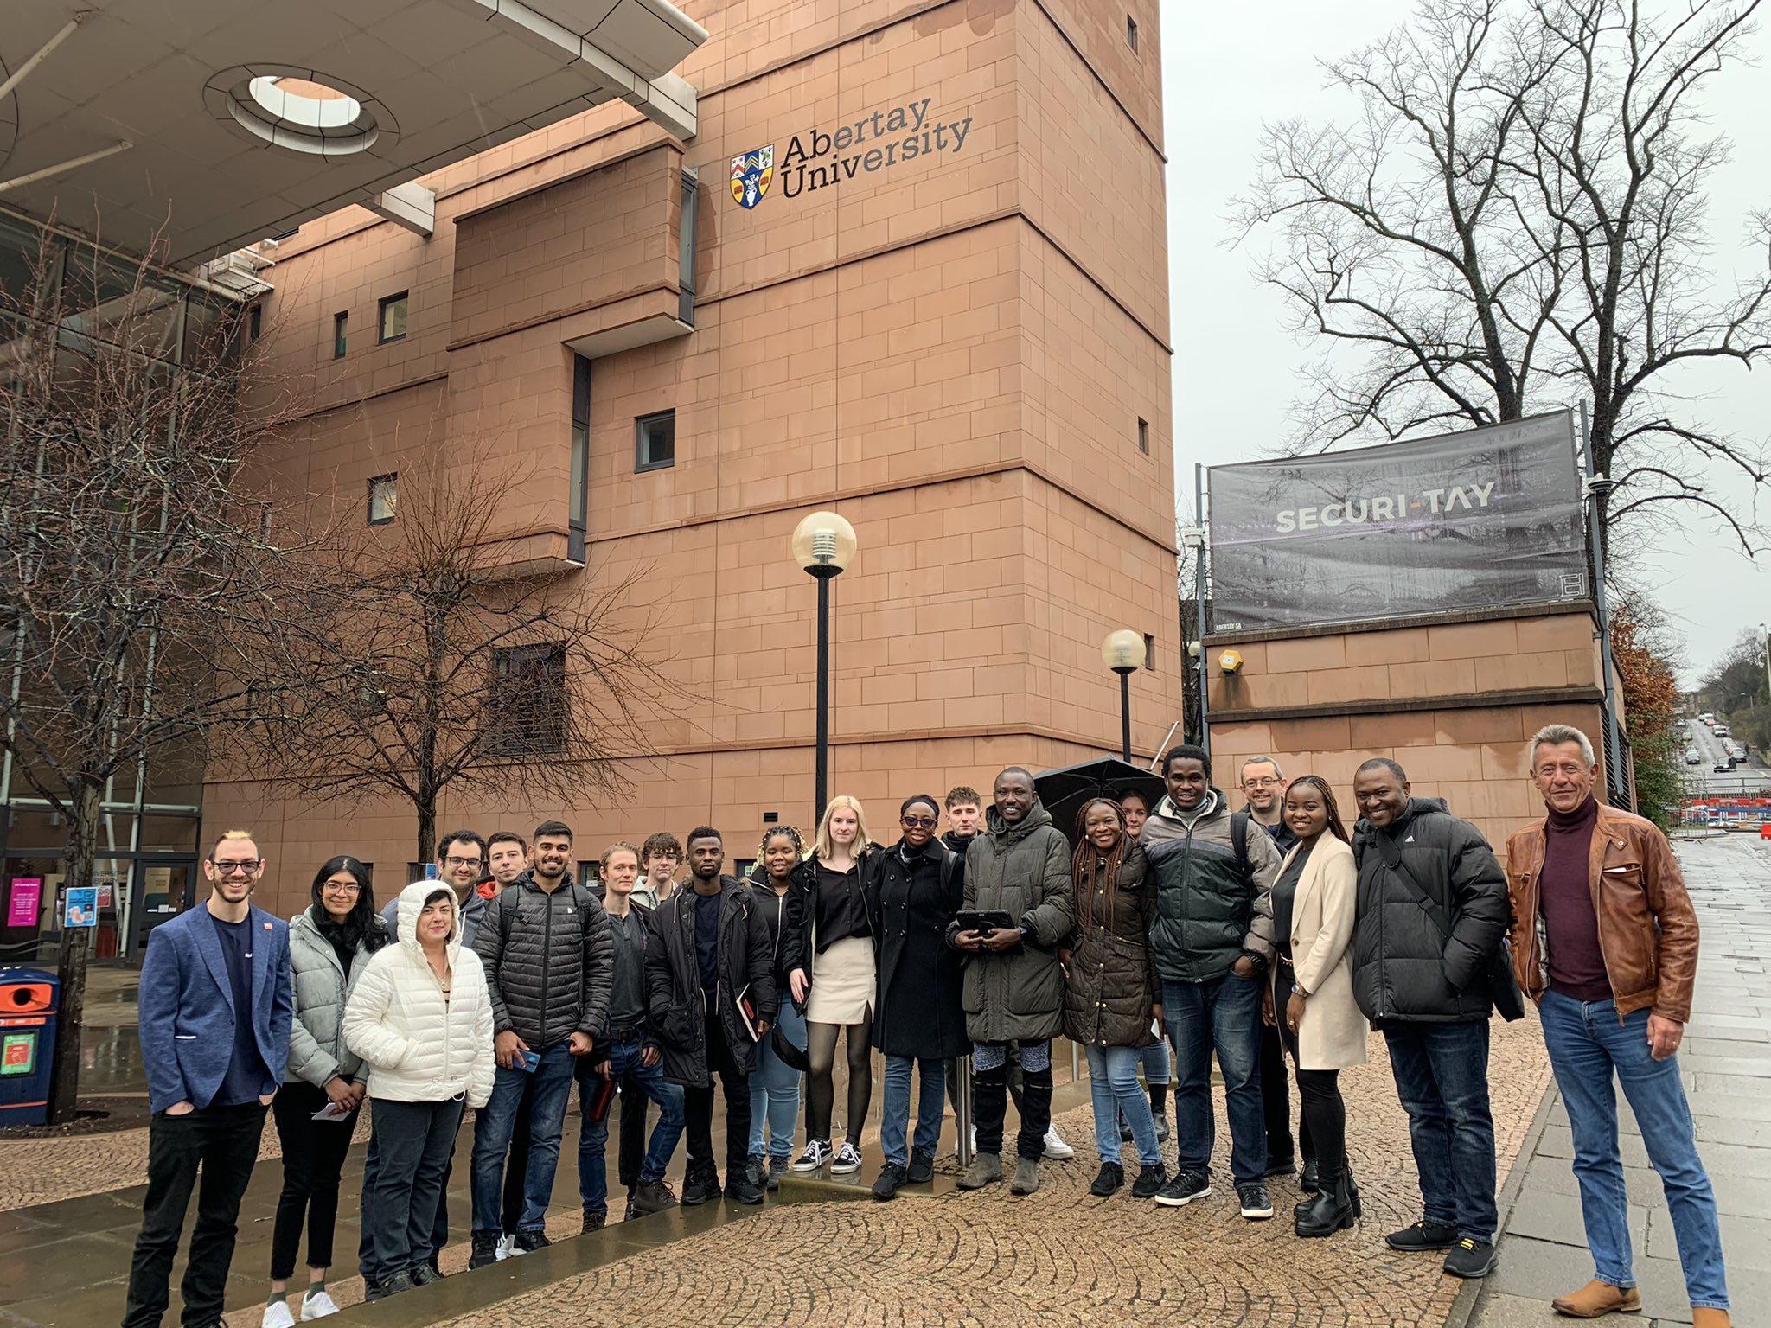

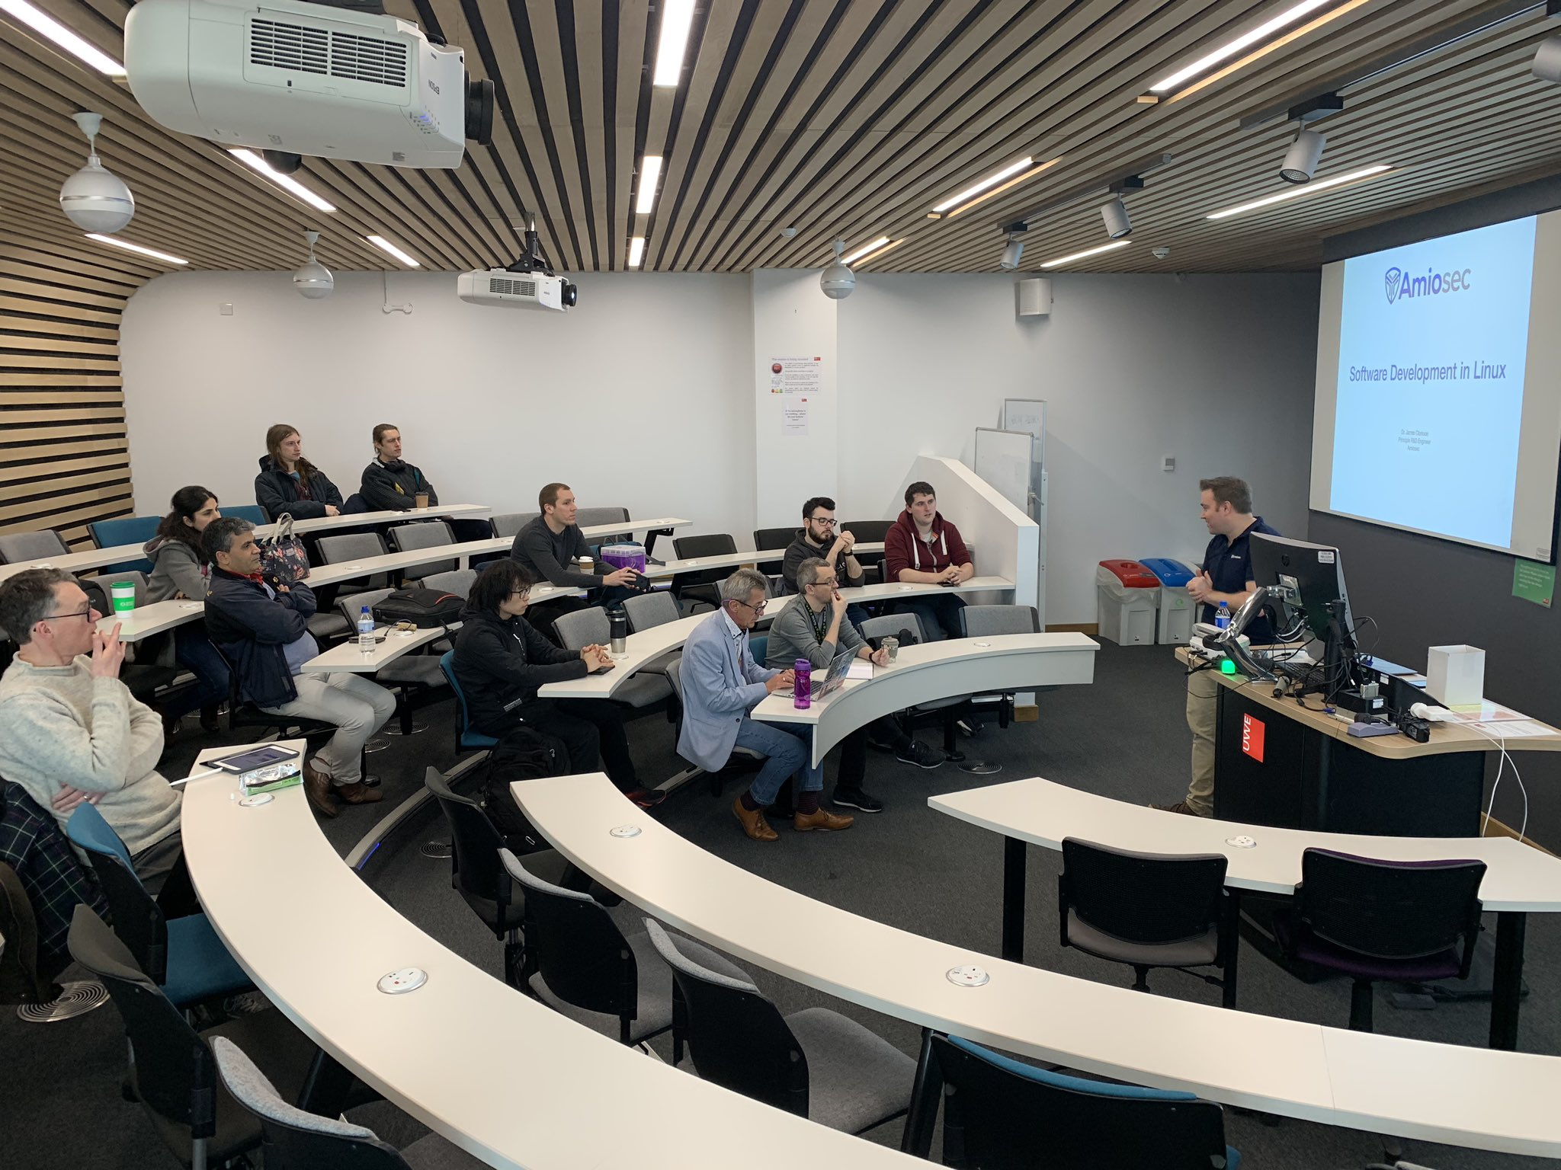


Slide 8






















Slide 9










